Slide 1
Embedding Values

Slide 2
Appendix 1:
Our Values in Action:
Managers’ Toolkit
If you have any questions, please email them to valuesinaction@qmul.ac.uk

Slide 3


Aim of this toolkit
There’s a range of different behaviours observed every day at Queen Mary, and we can sometimes take for granted those examples of supportive, inclusive, collaborative behaviour that is core to the way we want to work.
As a manger you have a key role in endorsing those positive behaviours.
This toolkit provides suggestions for how you might use Our Values in action to clarify behavioural expectations and plan for how you might support positive behaviours among your team members. It includes an away day activity.
Leading your team through discussion helps embed the understanding in a number of ways:
    It demonstrates your commitment to creating and embedding the culture we aspire to.
    By clarifying and supporting behavioural expectations, it makes managing a team a more rewarding and productive experience
It has been developed for teams but can be adapted for individual conversations.
“Setting an example is not the main means of influencing others; it is the only means.​”
Albert Einstein
If you have any examples of people living Our Values in action share with your Faculty Comms Manager, or with valuesinaction@qmul.ac.uk

Slide 4
How can you use Our Values in action in your team’s work?
As you allocate work among your team members, you have opportunities to emphasise a focus on Our Values in action.
Discuss the project/task with your team member(s), and prompt them to consider:
      How does this work contribute to Strategy 2030 and our Values?
      Ask your team member: “How will you ensure that you demonstrate Our Values in action during the work on this project?”
      Let them know that you’ll check back with them, support them and reflect on the outcomes with them …
      …. Plan the time to do that
Feedback highlights to the whole team

Slide 5
How can you use Our Values in action in your team’s work?
In your 1-to-1 meetings with your team members, you could consciously bring Our Values in action into the conversation.
This is an opportunity to:
      Reflect on any recent feedback (appreciative and/or constructive) they have been given, especially around their behaviours
      Discuss what development would offer the greatest benefit, to build on/address areas highlighted by that feedback
      Use Our Values in action to inform their development plan, discuss the support you can give
      Using the language from Our Values in action in your conversation will help embed Our Values into the conscious approaches we adopt in our work every day.

Slide 6
Preparing for Values Away day activity
Consider what data might help, for example:
  Staff survey
  Customer satisfaction data
  Any KPIs
  Future plans
Would it be helpful to gather feedback for the session, for example a survey from stakeholders?
What to send out before the session
  Our Values in action slides 15-19 below
  Key questions to get them thinking such as:
    Where have you seen our Values in action demonstrated?
    Where are our strengths? What could we improve?
      Particularly focussing on - hearing feedback, taking ownership, blocks to feeling empowered, where we need clarity on decision making.

Slide 7
Values Away Day Activities

Slide 8
Values: Team Away Day Activity
Agenda
Introduction
What are Queen Mary’s Values?
Activity 1 - getting to know our Values
Activity 2 - insight into action
Commitments and stories
Notes:
Agenda: Introduction
2 mins (out of 5 mins)
Welcome to our values workshop.
The aim of this session is to:
understand the Values – what they mean, and what they look like for us in our team
identifying areas of strength and weakness for us – the things that are within our own ability to change, rather than broader cultural issues which we can only influence indirectly
selecting a few local behaviour change actions
Let me very briefly run through the agenda and timing so you can see what’s in store.
By investing this time it will help us flourish and be successful, both individually and as a team
The first step could be to establish some ground rules for these meetings, that will endorse the expected behaviours. ​
You could include:​
​
What sort of behaviour is acceptable at the meeting?​
Permission for team members to call out negative behaviours. You might like to consider your Queen Mary Bystander options Queen Mary Bystander - Organisational and Professional Development (qmul.ac.uk)*. ​
Sharing successes: how will you do that?​
Space for each person’s contribution: how will you ensure that this happens?​
Structure to the meeting: what format will work for your team? Remember that we have meeting guidance around online meetings that will help us avoid screen-fatigue.​
​
*For behaviours that are not in line with Our Values in action make time to discuss in your next one to one with the member of your team concerned.
Let me remind you of the Values – these slides will have been sent to you prior to the workshop. The values were developed through wide consultation.

Slide 9

Inclusive
For all of us, this means:
Welcoming people, their voices and experience from our entire University and beyond, to add depth, insight, value and diversity of thought to everything we do
Striving for equity and fairness, and maintaining dignity and respect for all our communities
Actively considering the range of needs in our community
Nurturing and celebrating our networks of students, colleagues, and community
Respecting people's different skills and knowledge, acknowledging their contribution and their demands as well as their successes

Slide 10

Proud
For all of us, this means:
Highlighting our own and others’ successes
Ensuring we are informed about the University’s achievements, and celebrating them widely, recognising that we are stronger together than individually
Recognising our strengths, communicating and building on them
Providing appropriate, healthy challenge and support to others
Holding ourselves individually and collectively accountable for our commitments

Slide 11
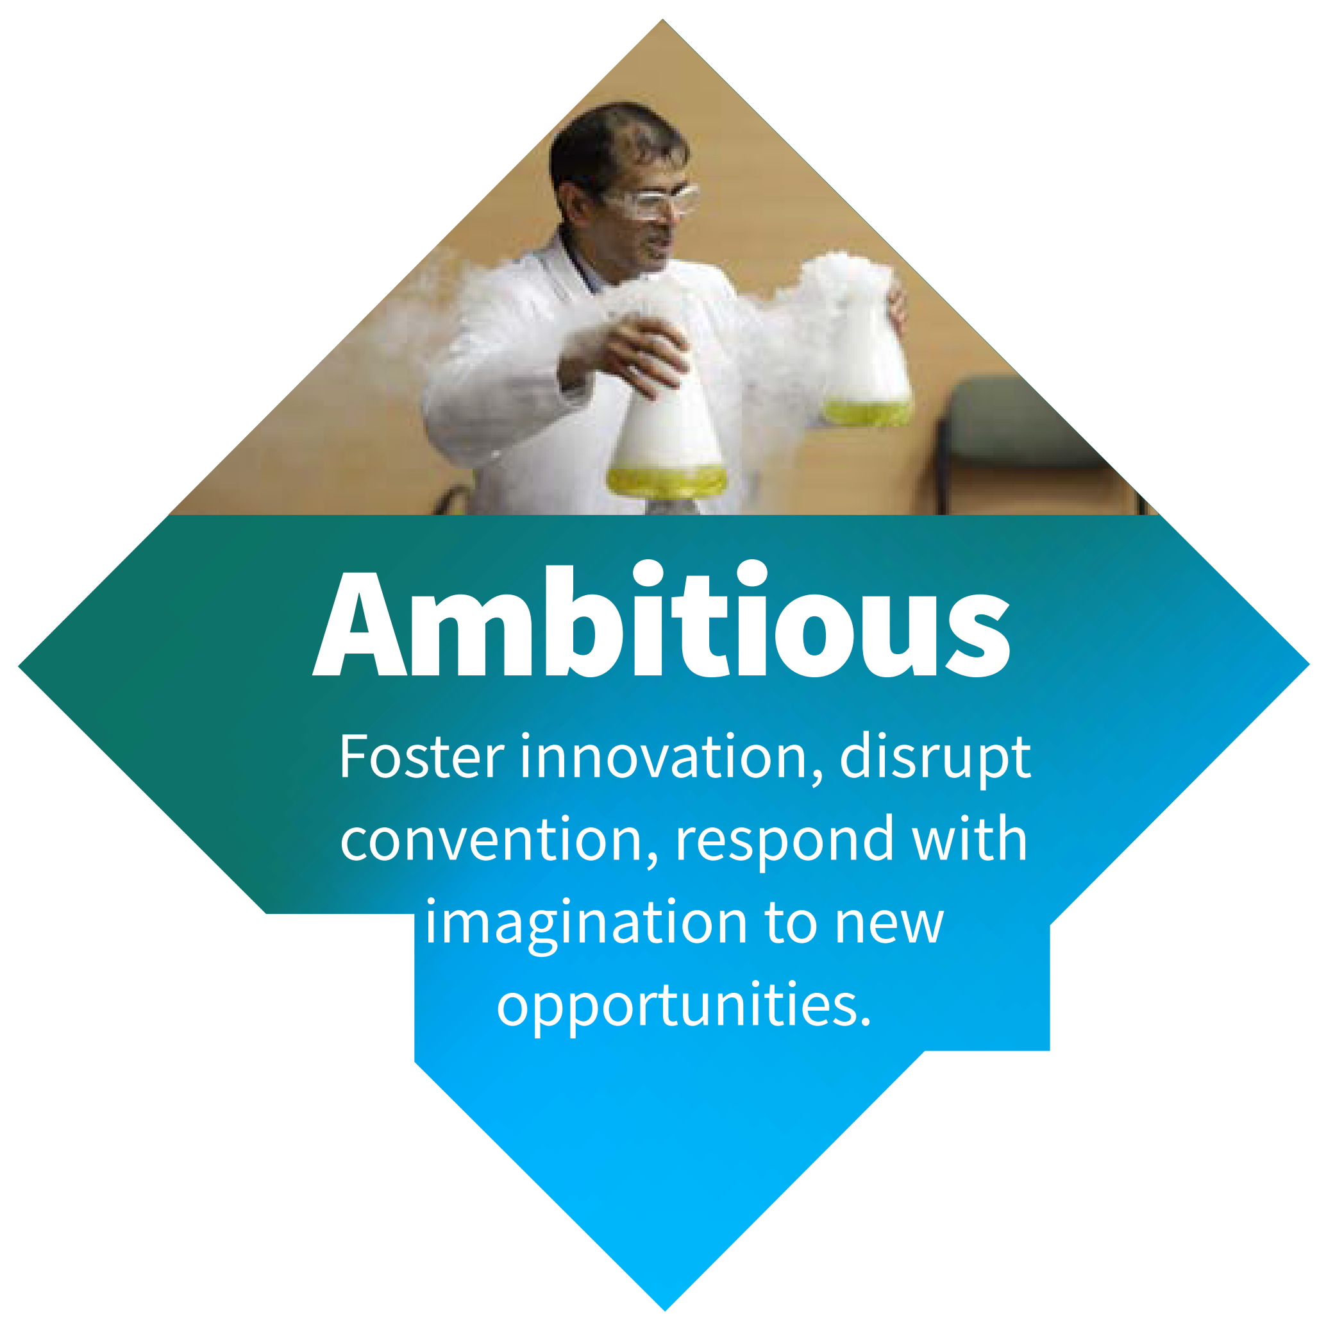
Ambitious
For all of us, this means:
Aiming for excellence in everything we do
Seeking out the best available evidence to inform sustainable, timely, robust decisions
Seeking opportunities for continuous improvement, being ready to challenge the status quo
Having the confidence to experiment with new and creative approaches
Understanding that we will sometimes fail, but having the confidence to acknowledge and learn from our mistakes and to support others to do likewise
Focusing on outcomes rather than processes
Being clear about our priorities, to sustain successful delivery

Slide 12

Collegial
For all of us, this means:
Working collaboratively, building strong partnerships across Queen Mary and beyond, to resolve major challenges
Seeking to understand academic and professional services challenges so that we can build healthy, productive working relationships
Being prepared to, and feeling comfortable to, share ideas as well as offering constructive challenge when appropriate
Listening to and acting on constructive and supportive feedback
Working with others to resolve issues respectfully, and committing to the decisions and outcomes
Actively supporting and endorsing each others' work and being committed to each others' success

Slide 13

Ethical
For all of us, this means:
Demonstrating Queen Mary Values through both our work and our behaviours
Acting with integrity at all times
Seeking out, implementing and championing good practice
Understanding our own capacity and capability to deliver
Accepting personal responsibility for resolving issues
Understanding our impact on others, including our partners and stakeholders
Building a supportive network to identify when we, or others, need help

Slide 14






Where will you use the Values?
Reward
- Academic promotion, Professorial Review
- Internal recruitment
- Staff bonus, GEM awards
Recruitment
- Job profiles
- Interviews
Everyday
- Where you work with others
- Planning and delivering your own work
- Reflecting on your work
Probation/ Appraisal
- Discussing how you will deliver future objectives
- Identifying development needs
Induction
- Welcome pages
- Welcome event
Everyday Management
- Setting expectations
- In regular comms
- Recognition
- Used in policies
- In development

Slide 15

Values in action through PS Transformation lens
How we are putting our Values in action through a PS Transformation lens
  A focus on behaviours we need for PS transformation
What do we need to do to be able to confidently take ownership for delivering and improving our services including:
  Make decisions
  Identify solutions
  Work effectively across professional boundaries
  Understand priorities

Slide 16
Getting to know Our Values in action
Activity 1: Divide into groups and allocate each group 1 or 2 Values
Spend 10-15 minutes talking about the Value(s) given to you
What does this Value mean to you?
What does this behaviour look like locally?
  Can you think of an example of where you have seen this Value being lived in your local area? (This might be a piece of work being completed or the way an individual behaved when delivering their work)
  Where have you used one of the Values in action? What went well and what could you do more of?
How is it relevant to PS Transformation and Departmental strategies/plans?
Is anything unclear that you’d like to ask the group about?
Feedback highlights to the whole group
What did the Value mean to your group and what does it look like?
Share examples put forward by your group where they have seen the Value being lived?
What are the connections between the Values and between Values in action and PS Transformation/Departmental Strategies/plans– how do build on these?
What possible tensions between Values might arise – how do we deal with them?
Notes:
Agenda: Activity 1 – Getting to know our values
25 mins + optional 10 mins (agenda time fully allocated to this slide)
[Divide attendees into small groups and allocate the five values out. The idea is that each group gets to talk about one or two of the values. If numbers are low, this exercise can be done individually.]
Spend 10-15 minutes talking about the value(s) given to you. Use the questions on the slide to prompt your discussion. Be prepared to feedback highlights to the whole group.
[Come back as a whole group, and ask each sub-group to feed back their thoughts. Others may highlight potential connections and tensions between elements of the value being described and elements of their value e.g. a potential tension between pace and inclusion, or pace and connecting with others.]
Now let’s hear highlights from around the room
What connections and possible tensions between different values might arise?

Slide 17
Insight into action (slide 1 of 2)
Activity 2:
10 mins: Divide into groups and use these questions to prompt you
10 mins: Feedback highlights of your discussion to the entire group
1
 | Strengths | Challenges
a. Initial thoughts | What would we say we are renowned for? Can these strengths be overplayed? What are the different strengths in the team? | What do we say we need to improve – individually and as a team? What bad habits don’t we talk about?
b. What would others say? | What feedback do we hear? Are we over confident? | Do we have any blind spots? What do we see as normal that others might see differently?
c. What is driving or reinforcing these behaviours? | What things encourage us to maintain these habits and behaviours? Are these ‘reinforcers’ healthy? | What things get in the way of us changing these habits and behaviours? What would happen if we did change?
2
Key insights | Three behaviour change actions
 | 1.
 | 2.
 | 3.
Notes:
Activity 2 – Insight into action
30 mins (out of 40 mins)
[You will find it helpful to print out this slide to use as a handout. Divide attendees into small groups – either the same as before or mix people up.]
Every team is made up of individuals, each of whom will demonstrate different behaviours and preferences, which is a healthy position to be in. As a manager, you can draw on this range to consider how it strengthens or challenges your team. ​
Let’s break into groups again.
Spend 10 minutes thinking about values strengths and weaknesses, including what might be driving or reinforcing these behaviour patterns. Use the questions on the slide and below to prompt you.
• How do we try to instill the value of ______ in our daily activities and program?
• If you had to identify and describe the work that another individual in our group is doing that exemplifies the value of ______, who is that and why?
• How has our group provided an environment for us to strive for the value of ______? What examples can we point to that demonstrate this commitment?
• How and where do we see the value of _____ alive and well in our team?
• How has the value of _________ formed and motivated our work, goals, and daily activities as a team?
• Where do we see the value of __________ exemplified by another group at Queen Mary? What can we learn from their example to strengthen our own commitment to _________?
• Where do we, as a group, fall short in demonstrating the value of ___________?
• What can we do to strengthen our commitment to the value of ____________ in our group and daily activities?
• How can we better exemplify the value of ____________? What do we need to change in order to do so?
Spend the next 10 minutes summarising key insights, and three ideas for behaviour change. These ideas could either target specific behaviours, or the drivers of these behaviours.
[Come back as a whole group. As the facilitator, you should look for the common ground. Try to get agreement to three behaviour change actions for the whole group to take forward.]
We’ll spend the last 10 minutes together, each group briefly presenting back their insights and ideas for behaviour change. From this we’ll try and find the three behaviour change actions we can take forward as a whole group.
Share these with your LT

Slide 18
Insight into action (slide 2 of 2)
1
Feedback
Key insights | Three behaviour change actions
 | 1.
 | 2.
 | 3.
Key insights
As a group, consider and discuss:
Consider how this links to other data/action plans you have
2
How you can create an environment where individual members of the team feel confident to communicate and challenge behaviour if they believe the Values have not been appropriately considered or followed? How and where can we give feedback to each other?
Considering your future work what Values in action might be particularly important?
What are the opportunities that might help us live our Values?
Notes:
Perhaps some notes here with suggestions on how you might handle feedback

Slide 19
Planning an Away Day?
If you’d like help planning or running a team Away Aay, the Organisational and Professional Development Team are here to support you.
Have a look at the OPD webpage to find out more
Or contact:
opd@qmul.ac.uk with your details

